Slide 1
Module 2
Logic based Knowledge Representation

Slide 2
Contents
Introduction
Propositional Logic
Predicate Logic
First order Logic, Properties of well-formed formulas (Wffs)
Conversion to Clausal Form
The Resolution Principle, Inference in First Order Logic (FOL)

Slide 3
INTRODUCTION

Slide 4

Introduction
Humans know things; and what they know helps them do things.
How the intelligence of humans is achieved?
by processes of reasoning that operate on internal representations of knowledge.

Slide 5
Representation
AI agents deal with knowledge (data)
Facts (believe & observe knowledge)
Procedures (how to knowledge)
Meaning (relate & define knowledge)
Right representation is crucial
Early realisation in AI
Wrong choice can lead to project failure
Active research area

Slide 6
In lay man term…
Knowledge - facts, information, and skills acquired through experience or education; the theoretical or practical understanding of a subject.
Reasoning- the action of thinking about something in a logical, sensible way
The process of thinking about something in order to make a decision
Logic- A particular way of thinking, especially one that is reasonable and based on good judgment
Inference- A guess that you make or an opinion that you form based on the information that you have
Deriving new sentences from old

Slide 7

Knowledge Representation & Reasoning
AI: The study and development of systems that demonstrate intelligent behavior
KR&R is the part of AI that is concerned with thinking and how thinking contributes to intelligent behavior
KR suggests an approach to understanding intelligent behavior that is radically different
Instead of studying humans very carefully (biology, nervous systems, psychology, sociology, etc.), it argues that what we need to study is what humans know.
It is taken as a given that what allows humans to behave intelligently is that they know a lot of things about a lot of things and are able to apply this knowledge as appropriate to adapt to their environment and achieve their goals.
KR&R focuses on the knowledge, not on the knower. We ask what any agent—human, animal, electronic, mechanical—would need to know to behave intelligently, and what sort of computational mechanisms might allow its knowledge to be manipulated.

Slide 8

Knowledge Based Agents
In AI, this approach to intelligence is embodied in knowledge-based agents - composed of a knowledge base and an inference mechanism.
It operates by
storing sentences about the world in its knowledge base,
using the inference mechanism to infer new sentences,
using these sentences to decide what action to take.

Slide 9
Knowledge Based Agents..
The central component of a knowledge-based agent is its knowledge base, or KB.
A knowledge base is a set of sentences.
Each sentence is expressed in a language called a knowledge representation language.
There must be a way to add new sentences to the knowledge base (TELL)and a way to query what is known(ASK).
The standard names for these operations are TELL and ASK , respectively.
Notes:
sentence” is used as a technical term. It is related but not identical to the sentences of English and other natural languages

Slide 10
Knowledge
“Amith knows that sun will rise tomorrow
Knowledge is a relation between a knower and a proposition
knower : Amith
proposition: the idea expressed by a simple declarative sentence, like “sun will rise tomorrow”
For KR&R, what matters about propositions is that they are abstract entities that can be true or false, right or wrong
When we say, “Amith knows that p,” we can just as well say, “Amith knows that it is true that p.”

Slide 11
Reasoning
What is reasoning? In general, it is the formal manipulation of the symbols representing a collection of believed propositions to produce representations of new ones.
Symbols are more accessible than the propositions they represent: They must be concrete enough that we can manipulate them (move them around, take them apart, copy them, string them together) in such a way as to construct representations of new propositions.
We might start with the sentences “Amith loves Buzo” and “Buzo is hurt” and after a certain amount of manipulation produce the sentence, “Someone Amith loves is hurt”
We would call this form of reasoning logical inference because the final sentence represents a logical conclusion of the propositions represented by the initial ones
Reasoning is a form of calculation, not unlike arithmetic, but over symbols standing for propositions rather than numbers

Slide 12
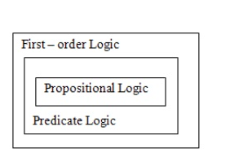
LOGIC
A logic is a formal language, with precisely defined syntax and semantics, which supports sound inference.
Different logics exist, which allow you to represent different kinds of things, and which allow more or less efficient inference.
The logic may be different types like propositional logic, predicate logic, temporal logic, description logic etc.

Slide 13
What is a Logic?
A language with concrete rules
No ambiguity in representation (may be other errors!)
Allows unambiguous communication and processing
Very unlike natural languages e.g. English
Many ways to translate between languages
A statement can be represented in different logics
And perhaps differently in same logic
Expressiveness of a logic
How much can we say in this language?
Not to be confused with logical reasoning
Logics are languages, reasoning is a process (may use logic)

Slide 14
Logic Representation
Logic is a great knowledge representation language for many AI problems
Propositional logic is the simple foundation and fine for some AI problems
First order logic (FOL) is much more expressive as a KR language and more commonly used in AI
There are many variations: horn logic, higher order logic, three-valued logic, probabilistic logics, etc.

Slide 15
Syntax and Semantics
Syntax
Rules for constructing legal sentences in the logic
Which symbols we can use (English: letters, punctuation)
How we are allowed to combine symbols
Semantics
How we interpret (read) sentences in the logic
Assigns a meaning to each sentence
Example: “All lecturers are seven foot tall”
A valid sentence (syntax)
And we can understand the meaning (semantics)
This sentence happens to be false (there is a counterexample)

Slide 16

Propositional Logic
Syntax
Propositions, e.g. “it is wet”
Connectives: and, or, not, implies, iff (equivalent)
Brackets, T (true) and F (false)
Semantics (Classical AKA Boolean)
Define how connectives affect truth
“P and Q” is true if and only if P is true and Q is true
Use truth tables to work out the truth of statements

Slide 17
Predicate Logic
Propositional logic combines atoms
An atom contains no propositional connectives
Have no structure (today_is_wet, john_likes_apples)
Predicates allow us to talk about objects
Properties: is_wet(today)
Relations: likes(john, apples)
True or false
In predicate logic each atom is a predicate
e.g. first order logic, higher-order logic

Slide 18
First Order Logic
More expressive logic than propositional
Used in this course (Lecture 6 on representation in FOL)
Constants are objects: john, apples
Predicates are properties and relations:
likes(john, apples)
Functions transform objects:
likes(john, fruit_of(apple_tree))
Variables represent any object: likes(X, apples)
Quantifiers qualify values of variables
True for all objects (Universal): ∀X. likes(X, apples)
Exists at least one object (Existential): ∃X. likes(X, apples)

Slide 19
Example: FOL Sentence
“Every rose has a thorn”
For all X
if (X is a rose)
then there exists Y
(X has Y) and (Y is a thorn)

Slide 20
Propositional Logic

Slide 21
PROPOSITIONAL LOGIC
A proposition is a declarative sentence (a sentence that declares a fact) that is either true or false, but not both.
Are the following sentences propositions?
Toronto is the capital of Canada.
Read this carefully.
1+2=3
x+1=2
What time is it?
(Yes)
(No)
(Yes)
(No)
(No)

Slide 22
Continued..
Propositional logic (PL) is the simplest form of logic where all the statements are made by propositions.
A proposition is a declarative statement which is either true or false.
It is a technique of knowledge representation in logical and mathematical form.
Examples:
Today is Sunday.
The Sun rises from West (False proposition)
3+3= 7 (False proposition)
5 is a prime number
Tomorrow is Holiday.

Slide 23
Continued..
Propositional Logic – the area of logic that deals with propositions
Propositional Variables – variables that represent propositions: p, q, r, s
E.g. Proposition p – “Today is Friday.”
Truth values – T, F

Slide 24
Syntax
The syntax of propositional logic defines the allowable sentences.
The atomic sentences consist of a single proposition symbol.
We use symbols that start with an uppercase letter and may contain other letters or subscripts
There are two proposition symbols with fixed meanings: True is the always-true proposition and False is the always-false proposition.
Complex sentences are constructed from simpler sentences, using parentheses and logical connectives.

Slide 25
Example:
2+2 is 4, it is an atomic proposition as it is a true fact.
"The Sun is cold" is also a proposition as it is a false fact.
Compound proposition - Compound propositions are constructed by combining simpler or atomic propositions, using parenthesis and logical connectives.
Example:
"It is raining today, and street is wet."
"Ankit is a doctor, and his clinic is in Mumbai."

Slide 26
Semantics
The semantics defines the rules for determining the truth of a sentence with respect to a particular model.
In propositional logic, a model simply fixes the truth value—true or false—for every proposition symbol.
For example, if the sentences in the knowledge base make use of the proposition symbols P1,2, P2,2, and P3,1, then one possible model is
m1 = {P1,2 =false, P2,2 =false, P3,1 =true} .
With three proposition symbols, there are 23 =8 possible models

Slide 27
1.1 Propositional Logic
DEFINITION 1
Let p be a proposition. The negation of p, denoted by ¬p, is the statement “It is not the case that p.”
The proposition ¬p is read “not p.” The truth value of the negation of p, ¬p is the opposite of the truth value of p.
Examples
Find the negation of the proposition “Today is Friday.” and express this in simple English.
Find the negation of the proposition “At least 10 inches of rain fell today in Miami.” and express this in simple English.
Solution: The negation is “It is not the case that today is Friday.” In simple English, “Today is not Friday.” or “It is not Friday today.”
Solution: The negation is “It is not the case that at least 10 inches of rain fell today in Miami.” In simple English, “Less than 10 inches of rain fell today in Miami.”

Slide 28
1.1 Propositional Logic
Note: Always assume fixed times, fixed places, and particular people unless otherwise noted.
Truth table:
Logical operators are used to form new propositions from two or more existing propositions. The logical operators are also called connectives.
The Truth Table for the Negation of a Proposition.
p | ¬p
T F | F T

Slide 29
Logical connectives.
Symbol Meaning priority
￢ negation, no 1
∧ conjunction, and 2
∨ disjunction, or 3
⇒ implication 4
⇔ equivalence 5
￢(not) -- ￢P is called the negation. Either an atomic sentence (a positive literal) or a negated atomic sentence (a negative literal).
∧ (and) -- P ∧ Q, is called a conjunction; its parts are the conjuncts.
[P= Rohan is intelligent, Q= Rohan is hardworking - P∧ Q]
∨ (or) -- P∨Q, is a disjunction of the disjuncts P and Q
[P= Ritika is Doctor. Q= Ritika is Engineer - P ∨ Q]

Slide 31
Logical connectives.
⇒ (implies) -- P ⇒ ￢Q, is an implication (or
conditional). Its premise or antecedent is P, and its conclusion or consequent is ￢Q. Implications are also known as rules or if–then statements. The implication symbol is sometimes written as ⊃ or →.
If it is raining, then the street is wet.
[P= It is raining Q= Street is wet - P → Q]
⇔ (equivalence) -- P ⇔ ￢Q is a biconditional. If and only if statements. Some books write this as ≡
If I am breathing, then I am alive

Slide 32
Truth tables for the five logical connectives

Slide 33
Propositional Logic
DEFINITION 2
Let p and q be propositions. The conjunction of p and q, denoted by p Λ q, is the proposition “p and q”. The conjunction p Λ q is true when both p and q are true and is false otherwise.
Examples
Find the conjunction of the propositions p and q where p is the proposition “Today is Friday.” and q is the proposition “It is raining today.”, and the truth value of the conjunction.
Solution: The conjunction is the proposition “Today is Friday and it is raining today.” The proposition is true on rainy Fridays.

Slide 34
Propositional Logic
DEFINITION 3
Let p and q be propositions. The disjunction of p and q, denoted by p ν q, is the proposition “p or q”. The conjunction p ν q is false when both p and q are false and is true otherwise.
Note:
inclusive or : The disjunction is true when at least one of the two
propositions is true.
E.g. “Students who have taken calculus or computer science can take this class.” – those who take one or both classes.
exclusive or : The disjunction is true only when one of the
proposition is true.
E.g. “Students who have taken calculus or computer science, but not both, can take this class.” – only those who take one of them.
Definition 3 uses inclusive or.

Slide 35
Propositional Logic
DEFINITION 4
Let p and q be propositions. The exclusive or of p and q, denoted by p q, is the proposition that is true when exactly one of p and q is true and is false otherwise.
The Truth Table for the Conjunction of Two Propositions.
p q | p Λ q
T T T F F T F F | T F F F
The Truth Table for the Disjunction of Two Propositions.
p q | p ν q
T T T F F T F F | T T T F
The Truth Table for the Exclusive Or (XOR) of Two Propositions.
p q | p q
T T T F F T F F | F T T F

Slide 36
Propositional Logic
Conditional Statements
DEFINITION 5
Let p and q be propositions. The conditional statement p → q, is the proposition “if p, then q.” The conditional statement is false when p is true and q is false, and true otherwise. In the conditional statement p → q, p is called the hypothesis (or antecedent or premise) and q is called the conclusion (or consequence).
A conditional statement is also called an implication.
Example: “If I am elected, then I will lower taxes.” p → q
implication:
elected, lower taxes. T T | T
not elected, lower taxes. F T | T
not elected, not lower taxes. F F | T
elected, not lower taxes. T F | F

Slide 37
Propositional Logic
Example:
Let p be the statement “Maria learns discrete mathematics.” and q the statement “Maria will find a good job.” Express the statement p → q as a statement in English.
Solution: Any of the following -
“If Maria learns discrete mathematics, then she will find a good job.
“Maria will find a good job when she learns discrete mathematics.”
“For Maria to get a good job, it is sufficient for her to learn discrete mathematics.”
“Maria will find a good job unless she does not learn discrete mathematics.”

Slide 38
Propositional Logic
DEFINITION 6
Let p and q be propositions. The biconditional statement p ↔ q is the proposition “p if and only if q.” The biconditional statement p ↔ q is true when p and q have the same truth values, and is false otherwise. Biconditional statements are also called bi-implications.
p ↔ q has the same truth value as (p → q) Λ (q → p)
“if and only if” can be expressed by “iff”
Example:
Let p be the statement “You can take the flight” and let q be the statement “You buy a ticket.” Then p ↔ q is the statement
“You can take the flight if and only if you buy a ticket.”
Implication:
If you buy a ticket you can take the flight.
If you don’t buy a ticket you cannot take the flight.

Slide 39
Propositional Logic
The Truth Table for the Biconditional p ↔ q.
p q | p ↔ q
T T T F F T F F | T F F T

Slide 40
Propositional Logic
Truth Tables of Compound Propositions
We can use connectives to build up complicated compound propositions involving any number of propositional variables, then use truth tables to determine the truth value of these compound propositions.
Example: Construct the truth table of the compound proposition
(p ν ¬q) → (p Λ q).
The Truth Table of (p ν ¬q) → (p Λ q).
p q | ¬q | p ν ¬q | p Λ q | (p ν ¬q) → (p Λ q)
T T T F F T F F | F T F T | T T F T | T F F F | T F T F

Slide 41
Propositional Logic
Precedence of Logical Operators
We can use parentheses to specify the order in which logical operators in a compound proposition are to be applied.
To reduce the number of parentheses, the precedence order is defined for logical operators.
Precedence of Logical Operators.
Operator | Precedence
¬ | 1
Λ ν | 2 3
→ ↔ | 4 5
E.g. ¬p Λ q = (¬p ) Λ q
p Λ q ν r = (p Λ q ) ν r
p ν q Λ r = p ν (q Λ r)

Slide 42
Propositional Logic
Translating English Sentences
English (and every other human language) is often ambiguous. Translating sentences into compound statements removes the ambiguity.
Example: How can this English sentence be translated into a logical expression?
“You cannot ride the roller coaster if you are under 4 feet
tall unless you are older than 16 years old.”
Solution: Let q, r, and s represent “You can ride the roller coaster,”
“You are under 4 feet tall,” and “You are older than
16 years old.” The sentence can be translated into:
(r Λ ¬ s) → ¬q.

Slide 43
Propositional Logic
Example: How can this English sentence be translated into a logical expression?
“You can access the Internet from campus only if you are a
computer science major or you are not a freshman.”
Solution: Let a, c, and f represent “You can access the Internet from
campus,” “You are a computer science major,” and “You are
a freshman.” The sentence can be translated into:
a → (c ν ¬f).

Slide 44
Interpretation of logic formulas
When we see a logic formula, we do not care about the original meaning of each proposition. Rather, we care about the logic relation between the propositions.
The main concern is to know if a logic formula is “true” or “false” when the values of the atomic formulas contained in this formula are given.
The process for determining the “true/false” of a logic formula based on the “true/false” of the atomic formulas is called “interpretation”.

Slide 45
Wff- well formed formula
A well-formed formula, wff, is a finite sequence of symbols from a given alphabet that is part of a formal language. A formal language can be identified with the set of formulas in the language. We represent propositions by formulas called well-formed formulas (wffs).
A sentence (wff- well formed formula) is defined as follows:
A symbol is a sentence
If S is a sentence, then ¬S is a sentence
If S is a sentence, then (S) is a sentence
If S and T are sentences, then (S ∨ T), (S ∧ T), (S → T), and (S ↔ T) are sentences
A sentence results from a finite number of applications of the rules

Slide 46
Properties of wffs in PL
Types of logic formula
Tautology: A tautology is a logic formula that is always true regardless of the true/false of the atomic formulas. A tautology is always “valid”.
Contradiction : If a logic formula is always false regardless of the true/false of the atomic formulas, we say it is a contradiction. A contradiction is unsatisfiable.
Satisfiable: If there exists a set of values for the atomic formulas that makes the logic formula true, this formula is satisfiable. This set of values is called an interpretation of the formula.
Equivalence- The wff V is equivalent to the wff W (written V ≡ W) iff V and W have the same truth value for each assignment of truth values to the propositional variables occurring in V and W.
Example. ¬ A ∧ (B ∨ A) ≡ ¬ A ∧ B and A ∨ ¬ A ≡ B ∨ ¬ B

Slide 47
Properties of wffs in PL
Propositional logic is also called Boolean logic as it works on 0 and 1.
Propositions can be either true or false, but it cannot be both.
Statements which are questions, commands, or opinions are not propositions such as "Where is Rohini", "How are you", "What is your name", are not propositions.

Slide 48
Properties of wffs in PL- Logical equivalence
Logical equivalence is one of the features of propositional logic. Two propositions are said to be logically equivalent if and only if the columns in the truth table are identical to each other.
Let's take two propositions A and B, so for logical equivalence, we can write it as A⇔B. In below truth table we can see that column for ¬A∨ B and A→B, are identical hence A is Equivalent to B

Slide 49
Properties of wffs in PL - Properties of Operators:
Commutativity:
P∧ Q= Q ∧ P, or
P ∨ Q = Q ∨ P.
Associativity:
(P ∧ Q) ∧ R= P ∧ (Q ∧ R),
(P ∨ Q) ∨ R= P ∨ (Q ∨ R)
Identity element:
P ∧ True = P,
P ∨ True= True.
Distributive:
P∧ (Q ∨ R) = (P ∧ Q) ∨ (P ∧ R).
P ∨ (Q ∧ R) = (P ∨ Q) ∧ (P ∨ R).
DE Morgan's Law:
¬ (P ∧ Q) = (¬P) ∨ (¬Q)
¬ (P ∨ Q) = (¬ P) ∧ (¬Q)
Double-negation elimination:
¬ (¬P) = P.

Slide 50
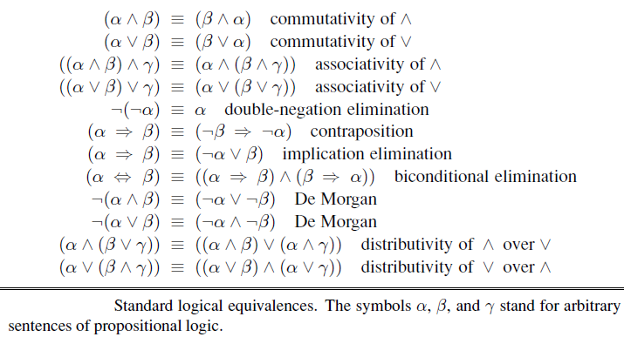

Slide 51
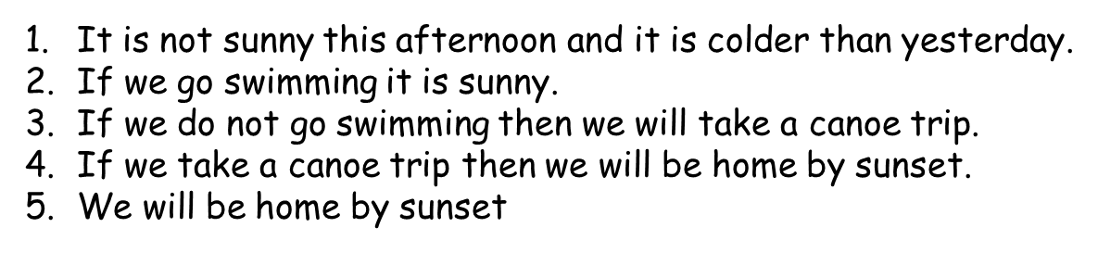
Example
propositions
hypotheses

Slide 52
Inference rules
Logical inference creates new sentences that logically follow from a set of sentences (KB)
An inference rule is sound if every sentence X it produces when operating on a KB logically follows from the KB
i.e., inference rule creates no contradictions
An inference rule is complete if it can produce every expression that logically follows from (is entailed by) the KB.
Logical inference is used to create new sentences that logically follow from a given set of sentences (KB).
In artificial intelligence, we need intelligent computers which can create new logic from old logic or by evidence, so generating the conclusions from evidence and facts is termed as Inference.

Slide 53
Rules of Inference
Inference rules are the templates for generating valid arguments. Inference rules are applied to derive proofs in artificial intelligence, and the proof is a sequence of the conclusion that leads to the desired goal.
Following are some terminologies related to inference rules:
Implication: It is one of the logical connectives which can be represented as P → Q. It is a Boolean expression.
Converse: The converse of implication, which means the right-hand side proposition goes to the left-hand side and vice-versa. It can be written as Q → P.
Contrapositive: The negation of converse is termed as contrapositive, and it can be represented as ¬ Q → ¬ P.
Inverse: The negation of implication is called inverse. It can be represented as ¬ P → ¬ Q.

Slide 54
The most commonly used Rules of Inference are tabulated below
1. Modus Ponens:
it states that if P and P → Q is true, then we can infer that Q will be true. It can be represented as:
Example:
Statement-1: "If I am sleepy then I go to bed" ==> P→ Q
Statement-2: "I am sleepy" ==> P
Conclusion: "I go to bed." ==> Q.
Hence, we can say that, if P→ Q is true and P is true then Q will be true.
Proof by Truth table:
P | Q | P → Q | P | Q
1 | 1 | 1 | 1 | 1
1 | 0 | 0 | 1 | No need
0 | 1 | 1 | 0 | No need
0 | 0 | 1 | 0 | No need

Slide 55
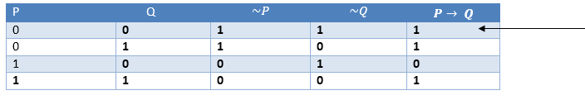
2. Modus Tollens:
The Modus Tollens rule state that if P→ Q is true and ¬ Q is true, then ¬ P will also true. It can be represented as:
Statement-1: "If I am sleepy then I go to bed" ==> P→ Q
Statement-2: "I do not go to the bed."==> ~Q
Statement-3: Which infers that "I am not sleepy" => ~P
Proof by Truth table:

Slide 56
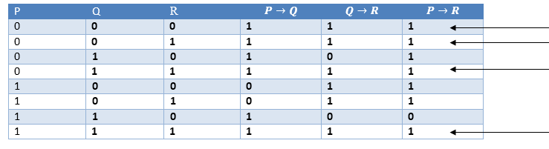
3. Hypothetical Syllogism:
The Hypothetical Syllogism rule state that if P→R is true whenever P→Q is true, and Q→R is true. It can be represented as the following notation:
Example:
Statement-1: If you have my home key then you can unlock my home. P→Q Statement-2: If you can unlock my home then you can take my money. Q→R Conclusion: If you have my home key then you can take my money. P→R

Slide 57
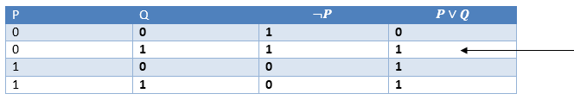
4. Disjunctive Syllogism:
The Disjunctive syllogism rule state that if P∨Q is true, and ¬P is true, then Q will be true. It can be represented as:
Statement-1: Today is Sunday or Monday. ==>P∨Q
Statement-2: Today is not Sunday. ==> ¬P
Conclusion: Today is Monday. ==> Q

Slide 58
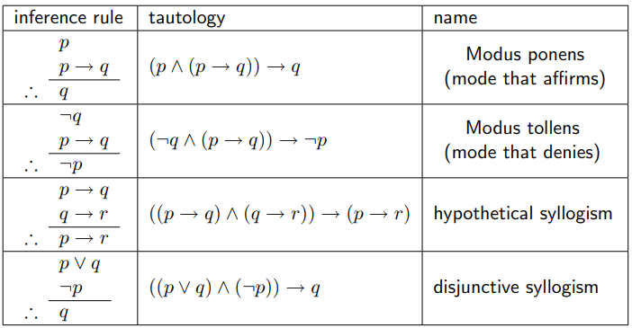

Slide 59
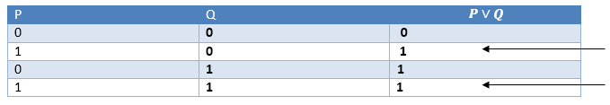
5. Addition:
The Addition rule is one the common inference rule, and it states that If P is true, then P∨Q will be true.
Example:
Statement: I have a vanilla ice-cream. ==> P
Statement-2: I have Chocolate ice-cream.
Conclusion: I have vanilla or chocolate ice-cream. ==> (P∨Q)

Slide 60
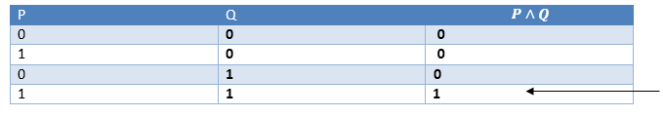
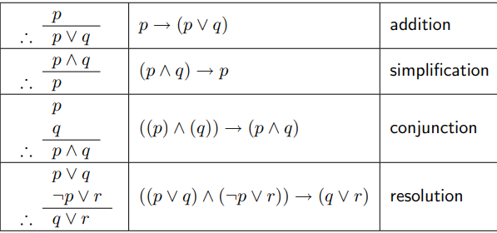
6. Simplification:
The simplification rule state that if P∧ Q is true, then Q or P will also be true. It can be represented as:

Slide 61
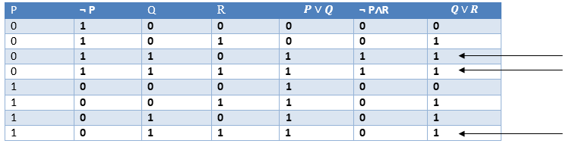
7. Resolution:
The Resolution rule state that if P∨Q and ¬ P∧R is true, then Q∨R will also be true. It can be represented as

Slide 62
Limitations of Propositional logic:
We cannot represent relations like ALL, some, or none with propositional logic. Example:
All the girls are intelligent.
Some apples are sweet.
Propositional logic has limited expressive power.

Slide 63
Propositional logic is a weak language
Hard to identify “individuals.” E.g., Mary, 3
Can’t directly talk about properties of individuals or relations between individuals. E.g. “Bill is tall”
Generalizations, patterns, regularities can’t easily be represented. E.g., all triangles have 3 sides
First-Order Logic (abbreviated FOL or FOPC) is expressive enough to concisely represent this kind of situation.
FOL adds relations, variables, and quantifiers, e.g.,
“Every elephant is gray”: ∀ x (elephant(x) → gray(x))
“There is a white alligator”: ∃ x (alligator(X) ^ white(X))

Slide 64
First Order Predicate Logic

Slide 65
First order Predicate Logic
First-order logic is another way of knowledge representation in AI. It is an extension to propositional logic.
FOPL is also known as Predicate logic or First-order predicate logic.
First-order logic is a powerful language that develops information about the objects in a more easy way and can also express the relationship between those objects.

Slide 66
Models for first-order logic
The models of a logical language are the formal structures that constitute the possible worlds under consideration. Each model links the vocabulary of the logical sentences to elements of the possible world, so that the truth of any sentence can be determined.
Models have objects in them! The domain of a model is DOMAIN the set of objects or domain elements it contains. The domain is required to be nonempty—every possible world must contain at least one object.
In the following figure, Richard and John are brothers. Formally speaking, a relation TUPLE is just the set of tuples of objects that are related.
Thus, the brotherhood relation in this model is the set
{ Richard the Lionheart, King John, King John, Richard the Lionheart }

Slide 67
Certain kinds of relationships are best considered as functions, in that a given object must be related to exactly one object in this way. For example, each person has one left leg, so the model has a unary “left leg” function that includes the following mappings:
Richard the Lionheart → Richard’s left leg
King John → John’s left leg .
Strictly speaking, models in first-order logic require total functions, that is, there must be a value for every input tuple.

Slide 68
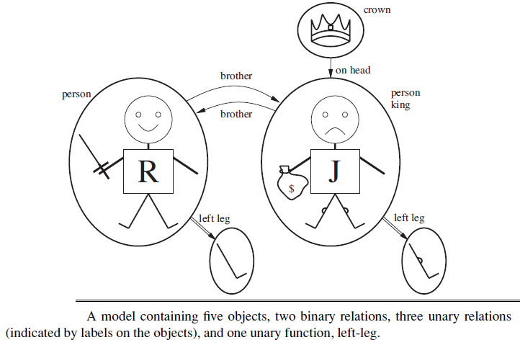

Slide 69
Symbols and interpretations
FOPL does not only assume that the world contains facts like propositional logic but also assumes the following things in the world like :
Objects: A, B, people, numbers, colors, wars, theories, squares, pits, ......
Relations: It can be unary relation such as: red, round, is adjacent, or n-any relation such as: the sister of, brother of, has color, comes between……
Function: Father of, best friend, third inning of, end of, .....
As a natural language, first-order logic also has two main parts:
Syntax
Semantics

Slide 70
Syntax of First-order Logic: Basic Elements
Constant 1, 2, A, John, Mumbai, cat,....
Variables x, y, z, a, b,....
Predicates Brother, Father, >,....
Function sqrt, LeftLegOf, ....
Connectives ∧, ∨, ¬, ⇒, ⇔
Equality ==
Quantifier ∀, ∃
We will use various kinds of individual constants that denote individuals/objects: a,b,c, names,…
Individual variables over objects: x, y, z , …
The result of applying a predicate P to a constant a is the proposition P(a) Meaning: the object denoted by a has the property denoted by P.
if P = “is a prime number”, then P(x) is the propositional form “x is a prime number”.

Slide 71
In addition to its objects, relations, and functions, each model includes an interpretation that specifies exactly which objects, relations and functions are referred to by the constant, predicate, and function symbols
Example; Richard refers to Richard the Lionheart and John refers to the evil King John.
Brother refers to the brotherhood relation, that is, the set of tuples of objects.
OnHead refers to the “on head” relation that holds between the crown and King John; Person, King, and Crown refer to the sets of objects that are persons, kings, and crowns.
LeftLeg refers to the “left leg” function,

Slide 72
Terms Atomic sentences
A term is a logical expression that refers TERM to an object. Constant symbols are therefore terms, but it is not always convenient to have a distinct symbol to name every object.
For example, in English we might use the expression “King John’s left leg” rather than giving a name to his leg. This is what function symbols are for: instead of using a constant symbol, we use LeftLeg(John).
Atomic sentences are the most basic sentences of first-order logic.
These sentences are formed from a predicate symbol followed by a parenthesis with a sequence of terms.
We can represent atomic sentences as
Predicate (term1, term2, ......, term n).
Example:
Ravi and Ajay are brothers: => Brothers(Ravi, Ajay).
Tom is a cat: => cat (Tom)

Slide 73
Complex Sentences:
Complex sentences are made by combining atomic sentences using connectives.
First-order logic statements can be divided into two parts:
Subject: Subject is the main part of the statement.
Predicate: A predicate can be defined as a relation, which binds two atoms together in a statement.
Consider the statement:
"x is an integer.“
In the sentence “The dog is sleeping”:
The phrase “the dog” denotes the subject - which the sentence is about.
The phrase “is sleeping” denotes the predicate- a property that is true of the subject.
Predicate logic will follow the same pattern.

Slide 74
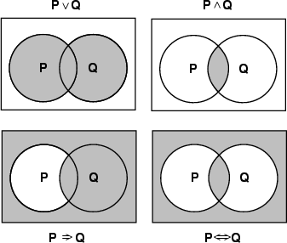
Complex Sentences:
￢Brother (LeftLeg(Richard), John)
Brother (Richard , John) ∧ Brother (John,Richard)
King(Richard ) ∨ King(John)
￢King(Richard) ⇒ King(John)
Fig: Models of complex sentences

Slide 75
Examples of Connectives in Use
“Simon lectures AI and bioinformatics”
lectures(simon,ai) ∧ lectures(simon,bioinfo)
“If Simon isn’t lecturing AI, Bob must be”
┓lectures(simon,ai) → lectures(bob,ai)
“George and Tony will win or Saddam will lose”
(will_win(george) ∧ will_win(tony)) ∨ ┓will_win(saddam)

Slide 76
Example of a Function
The cost of an omelette at the red_lion is $5”
cost_of is a function
Input: the name of a meal and the name of a Hotel
Output: the cost of the meal
cost_of (omelette, red_lion) = $5
“Omelettes at the Red Lion cost less than pancakes at House of Pancakes”
less_than (cost_of (omelette,red_lion), cost_of(pancake, pancake_house))
If we are talking about the output of a function
We can replace it with the predicate part
i.e., replace the RHS of equality with the LHS

Slide 77
Quantifiers
Universal quantifiers are often used with “implies” to form “rules”:
(∀x) student(x) → smart(x) means “All students are smart”
Universal quantification is rarely used to make blanket statements about every individual in the world:
(∀x)student(x)∧smart(x) means “Everyone in the world is a student and is smart”
Existential quantifiers are usually used with “and” to specify a list of properties about an individual:
(∃x) student(x) ∧ smart(x) means “There is a student who is smart”

Slide 78
Quantifiers in First-order logic:
There are two types of quantifier:
Universal Quantifier(∀)- (for all, everyone, everything)
Specifies that the statement within its range is true for everything or every instance of a particular thing.
In universal quantifier we use implication "→".
Existential quantifier(∃) - (for some, at least one)
Express that the statement within its scope is true for at least one instance of something.
In Existential quantifier we always use AND or Conjunction symbol (∧)

Slide 79
Quantifier Scope
Switching the order of universal quantifiers does not change the meaning:
(∀x)(∀y)P(x,y) ↔ (∀y)(∀x) P(x,y)
Similarly, you can switch the order of existential quantifiers:
(∃x)(∃y)P(x,y) ↔ (∃y)(∃x) P(x,y)
Switching the order of universals and existentials does change meaning:
Everyone likes someone: (∀x)(∃y) likes(x,y)
Someone is liked by everyone: (∃y)(∀x) likes(x,y)

Slide 80
“∀” is the. FOR ∀LL or universal quantifier. “∃” is the ∃XISTS or existential quantifier
For example,
∀x P(x) and ∃x P(x) are propositions
“the parking spaces at University” Let P(x) mean “x is full.”
∃x P(x) is the proposition saying that
“Some parking spaces at University are full.”
“There is a parking space at University that is full.”
“At least one parking space at University is full.”

Slide 81
“the parking spaces at University” Let P(x) mean “x is occupied”
∀ x P(x), is the proposition
“All parking spaces at University are occupied.”
“For each parking space at University, that space is full.”
The universally quantified sentence is equivalent to asserting the following five sentences:
Richard the Lionheart is a king ⇒ Richard the Lionheart is a person.
King John is a king ⇒ King John is a person.
Richard’s left leg is a king ⇒ Richard’s left leg is a person.
John’s left leg is a king ⇒ John’s left leg is a person.
The crown is a king ⇒ the crown is a person

Slide 82
∃ x Crown(x) ⇒ OnHead(x, John) .
Applying the semantics, the sentence says that at least one of the following assertions is true:
Richard the Lionheart is a crown ⇒ Richard the Lionheart is on John’s head;
King John is a crown ⇒ King John is on John’s head;
Richard’s left leg is a crown ⇒ Richard’s left leg is on John’s head;
and so on.
Now an implication is true if both premise and conclusion are true, or if its premise is false. So if Richard the Lionheart is not a crown, then the first assertion is true and the existential is satisfied.

Slide 83
Combining Quantifiers
∀ x ∃ y Loves(x,y)
For everyone (“x”) there is someone (“y”) that they love.
y ∀ x Loves(x,y)
There is someone (“y”) who is loved by everyone (“X”)
Clearer with parentheses: ∃ y ( ∀ x Loves(x,y) )
Notes:
Make consistent with text.

Slide 84
 | whether it is a negation, conjunction, disjunction, implication, universal formula, existential formula | Scope of The Quantizer | Free Variables | Whether it is a sentence
1. ∃x(A(x, y) ∧ B(x))
2. ∃x(∃y(A(x, y) → B(x))
3. ¬∃x(∃y(A(x, y))) → B(x)
4. ∀x(¬∃y(A(x, y)))
5. ∃x(A(x, y)) ∧ B(x)
6. ∃x(A(x, x)) ∧ ∃y(B(y))

Slide 85
 | whether it is a negation, a conjunction, a disjunction, an implication, a universal formula, or an existential formula | Scope of The Quantizer | Free Variables | Whether it is a sentence
1. ∃x(A(x, y) ∧ B(x)) | Existential | ∃x: (A(x, y) ∧ B(x)) | y | No
2. ∃x(∃y(A(x, y) → B(x)) | Existential | ∃x: (∃y(A(x, y) → B(x)) ∃y: A(x,y) | None | Yes
3. ¬∃x(∃y(A(x, y))) → B(x) | Implication | ∃x: (∃y(A(x, y)) ∃y: A(x, y) | x in B(x) | No
4. ∀x(¬∃y(A(x, y))) | Universal | ∀x : (¬∃y(A(x, y))) ∃y: A(x, y) | None | Yes
5. ∃x(A(x, y)) ∧ B(x) | Conjunction | ∃x: A(x, y)) | y, x in B(x) | No
6. ∃x(A(x, x)) ∧ ∃y(B(y)) | Conjunction | ∃x: (A(x, x)) ∃y: (B(y)) | None | Yes

Slide 86
Translating English to FOL
Every gardener likes the sun.
∀x gardener(x) → likes(x,Sun)
You can fool some of the people all of the time.
∃x ∀t person(x) ∧time(t) → can-fool(x,t)
You can fool all of the people some of the time.
∀x ∃t (person(x) → time(t) ∧can-fool(x,t))
∀x (person(x) → ∃t (time(t) ∧can-fool(x,t)))
All purple mushrooms are poisonous.
∀x (mushroom(x) ∧ purple(x)) → poisonous(x)
No purple mushroom is poisonous.
¬∃x purple(x) ∧ mushroom(x) ∧ poisonous(x)
∀x (mushroom(x) ∧ purple(x)) → ¬poisonous(x)
There are exactly two purple mushrooms.
∃x ∃y mushroom(x) ∧ purple(x) ∧ mushroom(y) ∧ purple(y) ^ ¬(x=y) ∧ ∀z (mushroom(z) ∧ purple(z)) → ((x=z) ∨ (y=z))
Clinton is not tall.
¬tall(Clinton)
X is above Y iff X is on directly on top of Y or there is a pile of one or more other objects directly on top of one another starting with X and ending with Y.
∀x ∀y above(x,y) ↔ (on(x,y) ∨ ∃z (on(x,z) ∧ above(z,y)))

Slide 87
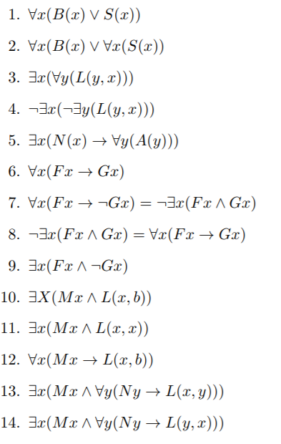
Translate the following sentences into FOL
Everything is bitter or sweet
Either everything is bitter or everything is sweet
There is somebody who is loved by everyone
Nobody is loved by no one
If someone is noisy, everybody is annoyed
Frogs are green.
Frogs are not green.
No frog is green.
Some frogs are not green.
A mechanic likes Bob.
A mechanic likes herself.
Every mechanic likes Bob.
Some mechanic likes every nurse.
There is a mechanic who is liked by every nurse.

Slide 88
Nested quantifiers
“Brothers are siblings” can be written as
∀ x ∀ y Brother (x, y) ⇒ Sibling(x, y) .
“siblinghood is a symmetric relationship”, we can write
∀ x, y Sibling(x, y) ⇔ Sibling(y, x) .
“Everybody loves somebody” means that for every person, there is someone that person loves:
∀ x ∃ y Loves(x, y) .
On the other hand, to say “There is someone who is loved by everyone,” we write
∃ y ∀ x Loves(x, y) .
[ Note:-The order of quantification is very important. It becomes clearer if we insert parentheses.
∀ x (∃ y Loves(x, y)) says that everyone has a particular property, namely, the property that they love someone. On the other hand, ∃ y (∀ x Loves(x, y)) says that someone in the world has a particular property, namely the property of being loved by everybody ]

Slide 89
Connections between ∀ and ∃
The two quantifiers are actually intimately connected with each other, through negation.
Asserting that everyone dislikes parsnips is the same as asserting there does not exist someone who likes them, and vice versa:
∀ x ￢Likes(x, Parsnips ) is equivalent to ￢∃ x Likes(x, Parsnips) .
“Everyone likes ice cream” means that there is no one who does not like ice cream:
∀ x Likes(x, IceCream) is equivalent to ￢∃ x ￢Likes(x, IceCream) .
Because ∀ is really a conjunction over the universe of objects and ∃ is a disjunction, they obey De Morgan’s rules. The De Morgan rules for quantified and unquantified sentences are as follows:
∀ x ￢P ≡ ￢∃x P ￢(P ∨ Q) ≡ ￢P ∧￢Q
￢∀x P ≡ ∃x ￢P ￢(P ∧ Q) ≡ ￢P ∨￢Q
∀x P ≡ ￢∃x ￢P P∧ Q ≡ ￢(￢P ∨￢Q)
∃x P ≡ ￢∀x ￢P P∨ Q ≡ ￢(￢P ∧￢Q) .

Slide 90
Equality
We can use the equality symbol to signify that two terms refer to the same object. For example,
Father (John)=Henry
says that the object referred to by Father (John) and the object referred to by Henry are the same. Because an interpretation fixes the referent of any term, determining the truth of an equality sentence is simply a matter of seeing that the referents of the two terms are the same object.
It can also be used with negation to insist that two terms are not the same object. To say that Richard has at least two brothers, we would write
∃ x, y Brother (x,Richard ) ∧ Brother (y,Richard ) ∧￢(x=y) .
The sentence
∃ x, y Brother (x,Richard ) ∧ Brother (y,Richard )
does not have the intended meaning

Slide 91
Variables
“There’s a meal at the Red Lion which costs $3” (more expressive now)
cost_of(meal,red_lion) = 3
We’re really talking about some general meal
Not a meal in particular
Call this meal X (a variable)
cost_of (X, red_lion) = 3
need to express “There is such a meal X”. This is represented as: ∃
The exists sign is known as a existential quantifier
∃ X (cost_of (X, red_lion) = 3)

Slide 92
Examples
“There is a meal at the Red Lion which costs three pounds”
∃ X (meal(X) ∧ cost_of (red_lion, X) = 3)
“All the meals at the Red Lion cost three pounds”
Replace exists by forall:
∀ X (meal(X) ∧ cost_of (red_lion, X) = 3)
∀ X (meal(X) → cost_of(red_lion, X) = 3)
“Every Monday and Wednesday I go to John’s house for dinner”
∀ X (day(X,mon) ∨ day(X,weds)
→ go(me, house(john)) ∧ eat(me,dinner))

Slide 93
“All things in the bag are red”
Which of these translations is correct?
1. ∃ X (in_bag(X) → red(X))
2. ∀ X (red(X) → in_bag(X))
3. ∀ X (∀ Y (bag(X) ∧ in_bag(Y,X) → red(Y)))

Slide 94
USING FIRST-ORDER LOGIC
Assertions and queries in first-order logic
Sentences are added to a knowledge base using TELL, exactly as in propositional logic. Such sentences are called assertions. For example, we can assert that John is a king, Richard is a person, and all kings are persons:
TELL(KB, King(John)) .
TELL(KB, Person(Richard)) .
TELL(KB, ∀ x King(x) ⇒ Person(x)) .
We can ask questions of the knowledge base using ASK. For example
ASK(KB, King(John))
returns true. Questions asked with ASK are called queries or goals. Generally speaking, any query that is logically entailed by the knowledge base should be answered affirmatively.

Slide 95
USING FIRST-ORDER LOGIC
For example, given the two preceding assertions, the query ASK(KB, Person(John))
should also return true. We can ask quantified queries, such as
ASK(KB, ∃ x Person(x))
The answer is true, but this is perhaps not as helpful as we would like. It is rather like answering “Can you tell me the time?” with “Yes.” If we want to know what value of x makes the sentence true, we will need a different function, ASKVARS, which we call with
ASKVARS(KB, Person(x))
In this case there will be two answers: {x/John} and {x/Richard}. Such an answer is called a substitution or binding list.

Slide 96
Practical Applications of Predicate Logic
Basis for proving correctness of computer programs
Basis for many Artificial Intelligence systems.
Predicate-logic like statements are supported by some sophisticated database query engines

